Slide 1
Controlled Placement of FPGA Resources
5/25/2020
Noeloikeau Charlot

Slide 2
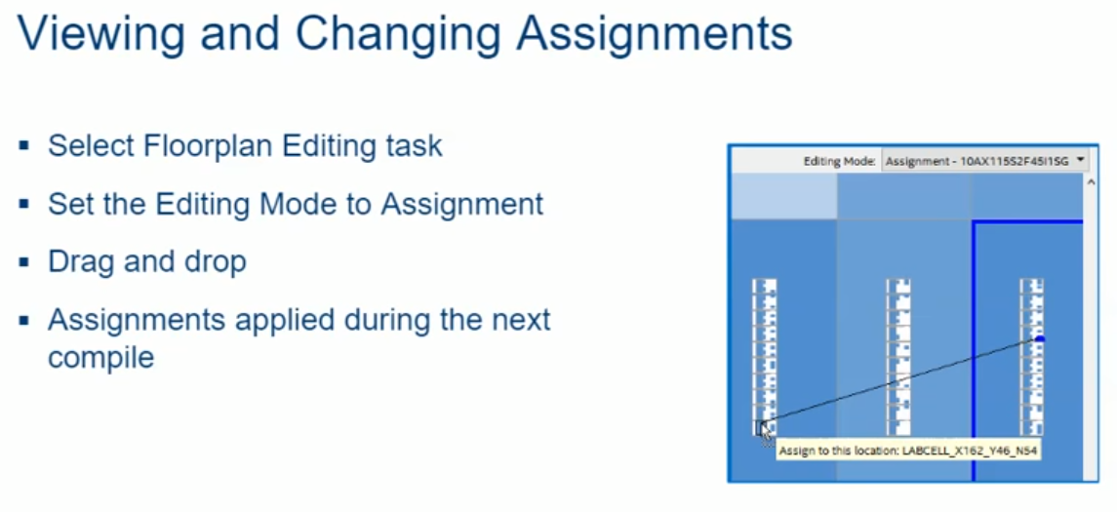

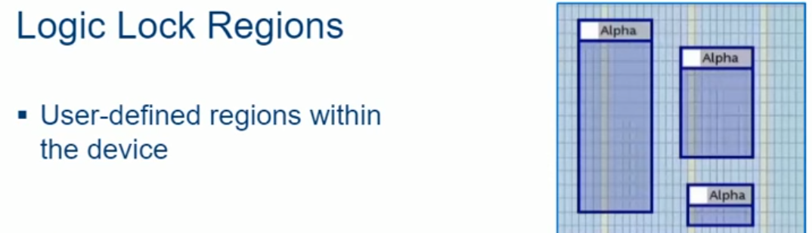
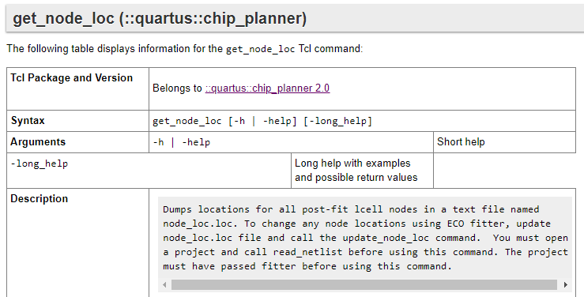
Specifying logic locations on chip
Can do in a few ways
1) drag and drop
2) directly in QSF
3) logic lock regions (broad specification)
4?) possibly editing .loc file?

Slide 3
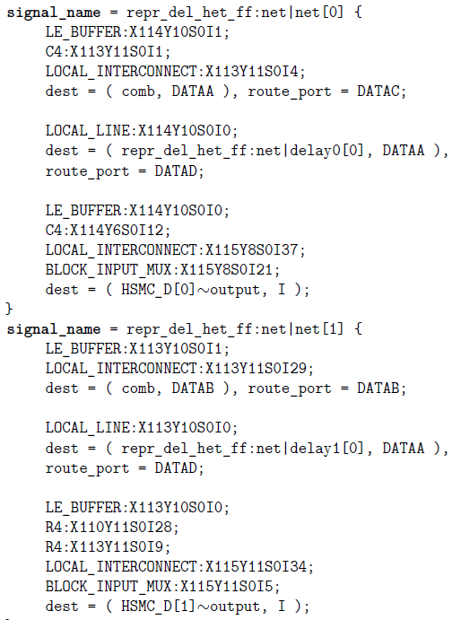
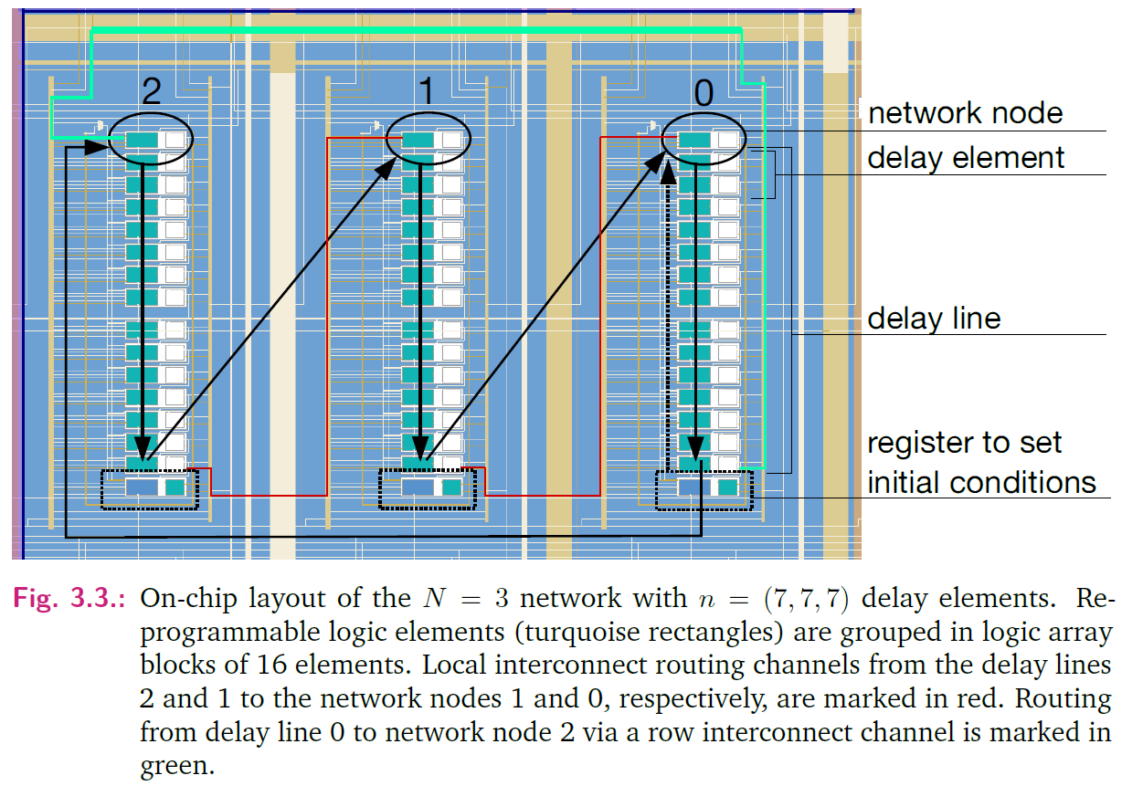
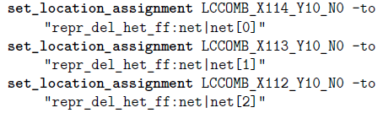
Example: Lohmann (under thesis in google drive)

Slide 4
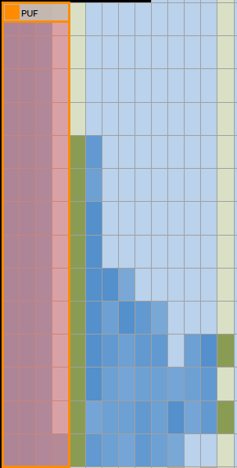
Logic Lock
Allows segregation of logic
Prevents other logic from being placed in region
In this way the PUF is separate from rest of design
Uses commands like:
set_global_assignment -name LL_RESERVED ON -section_id PUF (to prevent other logic placed in PUF)
set_instance_assignment -name LL_MEMBER_OF PUF -to "Ring_Module:Ring[0].Node_Name|node[0]" -section_id PUF
Can also be done in Chip Planner GUI

